Slide 1
CVP Relationships in Graphic Form
Viewing CVP relationships in a graph gives managers a perspective that can be obtained in no other way. Consider the following information for Falcon Cycles Ltd.:

Slide 2
Total Sales
Total Expenses
Profit Area
Pounds
Break-even point
Loss Area
Units
Fixed expenses

Slide 3
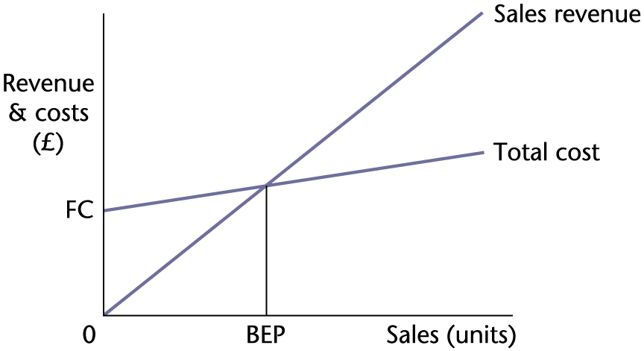
Fundamental Structure of the Breakeven Chart

Slide 4
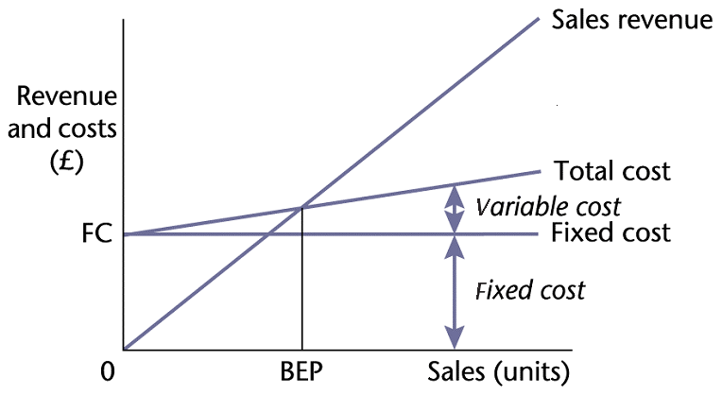
Traditional Breakeven
Chart

